Slide 1

Accepting Diversity : Creating an Inclusive Classroom
Dr. Gowramma I. P.
Associate Professor
Department of Education
Regional Institute of Education, Bhubaneswar

Slide 2
CONTEXT
Diversity of society reflected in the school process are misunderstood as obstacles for education and treated as threat to school functioning and classroom processes. But the reality is that diversities are resources that could be converted into rich dividends for the all round development of young children thus promising an inclusive society in the future.
The philosophy behind creating an inclusive classroom is to develop the belief that every student is unique and each one is a potential learner. The management and utilization of individual potential to the progress of a society is a responsibility which a school has to accept.
NCTE 2014 regulation has suggested a course with the intention to develop a thought among teachers which results in accepting ‘all’ children in the class as their responsibility.
An effort is made to give the pre-service teachers an opportunity for reflection in and on action as a beginning to bring in the much awaited change in the classroom through the field engagement activity of the 2nd semester ‘the multicultural placement’.

Slide 3
Objectives
By making use of the multicultural school exposure it was intended to -
Develop a conviction that all children can learn and grow
Explore the possibilities of creating inclusive classrooms
Analyse the roles and responsibilities of teachers for addressing diversity of students
Develop the skill of identifying inclusive pedagogy for promoting learning of all children in the classroom

Slide 4
Process
The students were placed for multicultural exposure for 2 weeks, with exposure into different types of schools – urban, semi urban and rural from government and private management.
This exposure was utilized to serve as an important link between the theory and practice as recommended by the visionaries of NCTE 2014. This is seen as a small step for a teacher towards change at the individual level, but a giant leap to transform the system and society.

Slide 5
Methodology
Methodology followed was that of Grass-root approach where in the initial period based on informal interviews and observations raw data was drawn
The ideas that could lead to an inclusive classroom was generated by the students themselves based on their experience which they were able to merge with the theoretical inputs that have been imparted to them in the class through text and other references.
The rigorous discussions that went on in the class, during the multi-cultural setting both with the subjects and among the student-teachers themselves merged together with the view-points brought by the groups representing the two separate states, ultimately culminated into a holistic approach

Slide 6
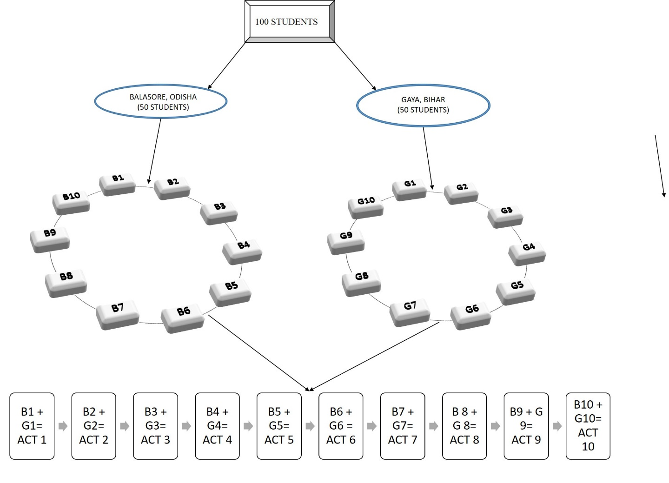
The Process / (Practice)

Slide 7
Step - I
Before field engagement, activities to be performed were planned. Following are the 10 areas identified to work
1. Informal interaction with teachers to ascertain the current challenges for promoting inclusive education. Collect their opinion on including children with disabilities in their schools.
2. Observe the physical environment and infrastructure with reference to accessibility to school by all the children. Come out with possible alternatives.
3. Observe the school practices and pedagogical interventions. Are the school practices and pedagogy meeting the needs of ‘ALL’ children? Critically analyse.
4. Study and observe the assessment and evaluation practices being followed in the school. Critically reflect upon the practices in the context of inclusive education.
5. Observe one class and reflect on the behaviour, language and the examples used by the teacher from the perspective of gender inclusion.

Slide 8
Step - I
6. Interact with the students regarding their views on inclusion of children with disabilities in their schools/class as their peers. Document and share your experiences during interaction.
7. Observe and make a list of government facilities being utilized by the administration to include the students with diverse needs. Comment on policy and practice.
8. Observe and interact with teachers to analyse their role in building an inclusive school culture and classroom practices.
9. Discuss with head teachers /class teachers regarding how they are concerned regarding enhancing partnership to promote inclusive education. Find out how they are working together with parents and community to support the additional needs of the students
10. Based on the observation of a classroom, identify the gaps in pedagogical practices that may not reach all children. Suggest ways to modify the plan so that all the children in the class are benefited.

Slide 9
Step - II
The students observed, interacted with students, teachers, head teachers, parents and developed their perspectives based on the ten themes
Step - III
On returning to the institute, the group of students from both the clusters came as a panel and narrated their learning with additional information they had gathered through reading resource material and discussing with each other.
The classroom provided a vibrant space for their voice to reverberate and reassure that they can be the agents of change with change in their attitude and modification in their approach in the classroom

Slide 10
Impact of the practice
Students were provided an opportunity to generate knowledge in the situation they are placed and it was done sucessfully.
Students started interacting, observing and discussing with the group in the lines of the task at hand they developed interest and started reading to strengthen their reflection and also to continue the thought to come out with ideas that could be better in the similar situation
Students expressed their desire to continue this in the 3rd semester during the internship.
Most students requested for more time for presentation in the form of power point and video, a clear sign of their confidence to speak their experience.

Slide 11
Innovation
Novelty - moving away from the twin devil of pedagogy - lecture and reading from book for exam
Possibility of replication - can be done by every teacher educator for the respective course taught
Cost effectiveness - does not involve any additional expense as it is merged with the multicultural placement
Usefulness - students’ excitement was evident in their discussion, and in feedback collected most of them have expressed their happiness of learning, suggested to continue in the 3rd semester during internship- the try out. We have decided to design lesson plans to cater to the diversity and try out in classroom during internship.

Slide 12
Innovation - how exactly it worked
Professionalism in teaching should extend beyond the core knowledge and skills to address the social aspects and consequences of educational practices (Grant & Agosto, 2008).
This effort was to integrate the perspectives such as critical theory into the teacher preparation programme to frame discussion around practice.
Society reflecting into the school was targeted by piercing through the eyes of a prospective teacher to build professionalism among them for the successful practice of inclusive education in the future
The major intention of taking up this innovation was to emphasise professional and ethical responsibility within a framework of social justice into teacher preparation, not just imparting knowledge and skill

Slide 13
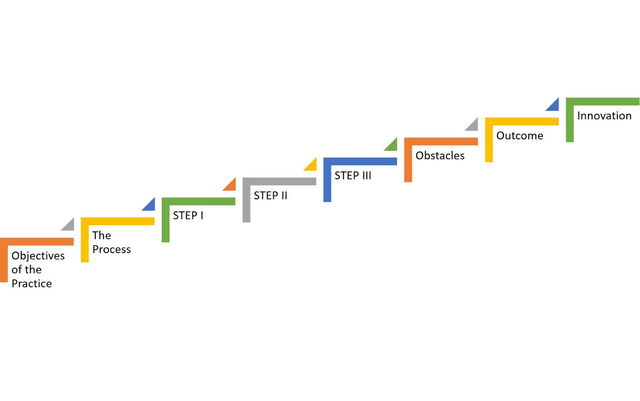
The representation of the innovation

Slide 14
Contact person for further details
Dr. Gowramma I P
Department of Education
Regional Institute of Education, Bhubaneswar.

